Slide 1
Netflix Clone Website Project
AICT LAB
Group members:
SAAD ALI 216
KHUZAIMA 221
ZESHAN 231
JUNAID 193
Instructor Name:
Miss Ramsha
Usman Ishfaq

Slide 2
AICT LAB
Project Objectives:
Clone Netflix-style UI for learning purposes
Practice HTML, CSS
Apply responsive web design principles
Support website using Excel-based data analysis

Slide 3
AICT LAB
Website Overview:
Netflix-inspired homepage layout
Categorized movie sections
Static front-end website
Educational and non-commercial project

Slide 4
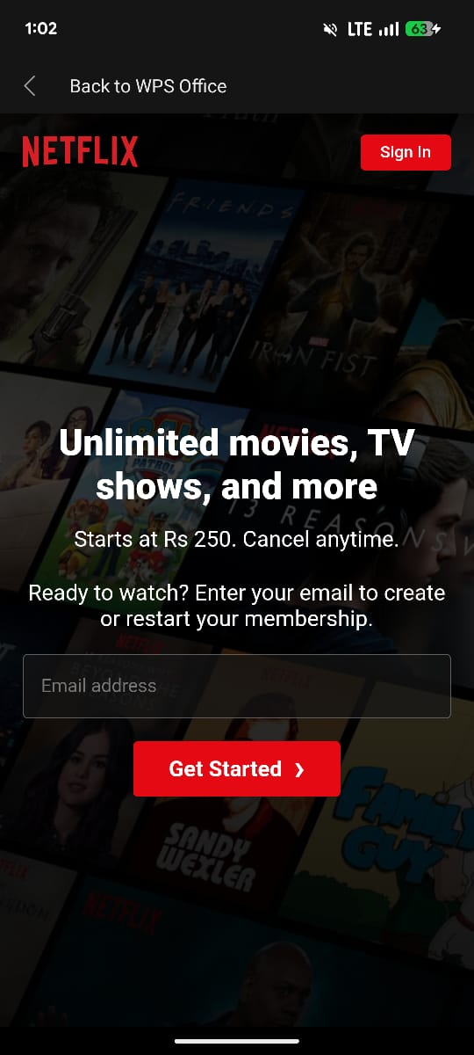
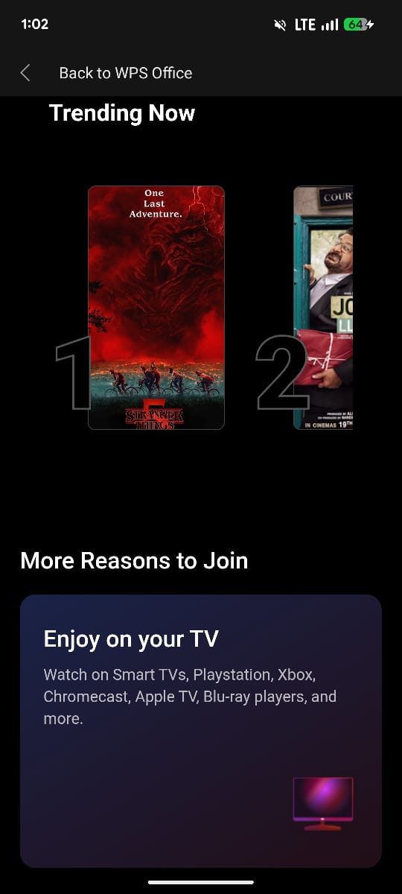
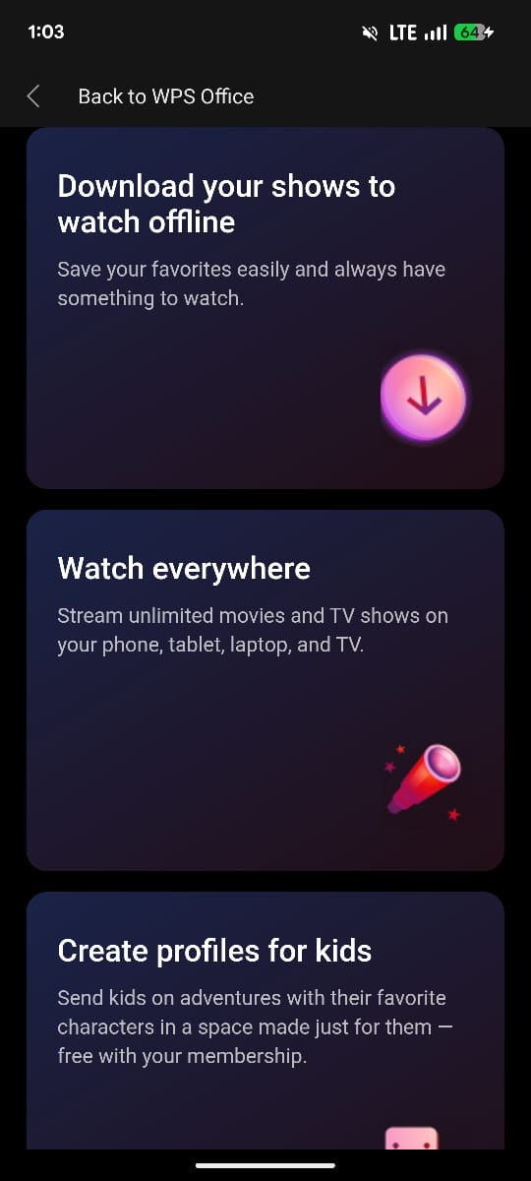
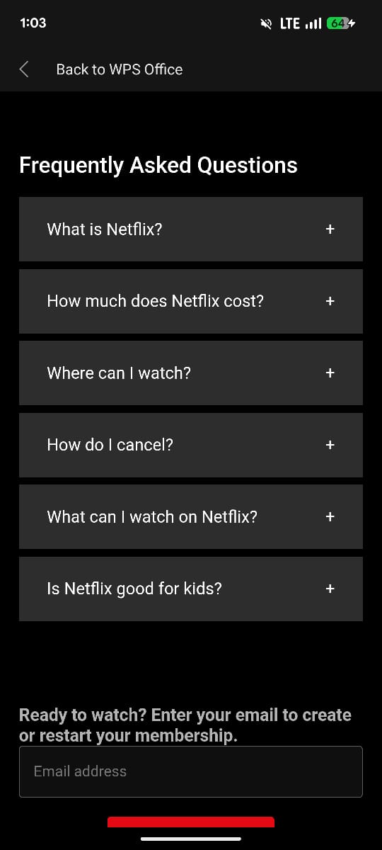
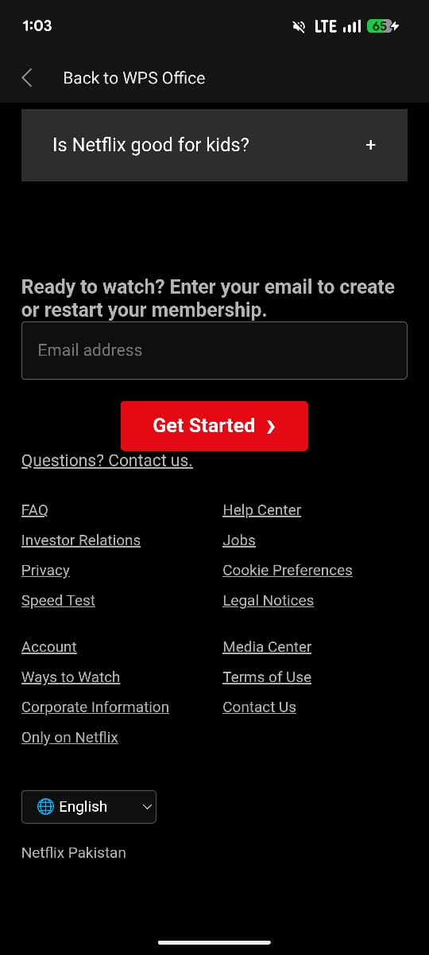
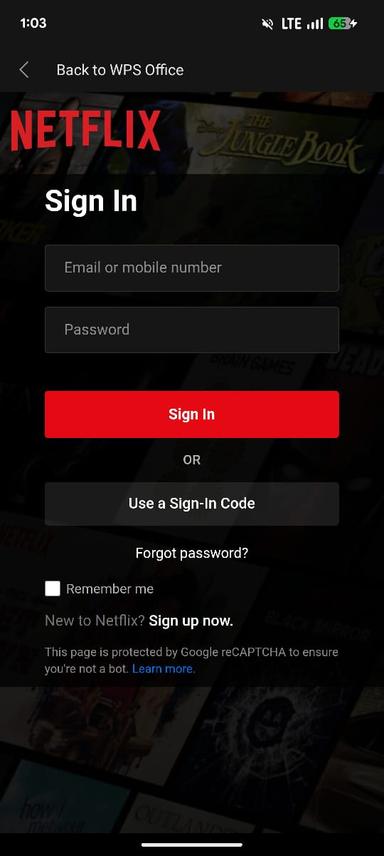
AICT LAB
Home Page Demo:
Hero banner with featured content
Horizontal scrolling movie rows
Dark theme UI for cinematic feel

Slide 5
AICT LAB
Content:
Categories: Trending Now, Originals, Action, Comedy
Grid-based layout
Easy navigation and readability

Slide 6
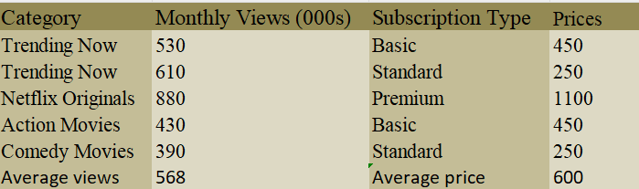
AICT LAB
Excel Data (Raw & Calculations)::
Raw Data: categories, titles, monthly views
Calculations using:
SUM
AVERAGE
COUNTIF
Data validation dropdown
Conditional formatting

Slide 7
AICT LAB
Excel Dashboard & Chart:
Chart: Content Views by Category
Trending Now: 1140
Netflix Originals: 880
Action Movies: 430
Comedy Movies: 390

Slide 8
AICT LAB
Design Decisions:
Dark background with red highlights
Netflix-style typography Grid and row-based layout
Minimal UI focusing on content

Slide 9
AICT LAB
Design Live Demo & GitHub Live Website :
GitHub Pages:
GitHub Repository:
https://github.com/username/netflix-clone

Slide 10
Reflection & Next Steps:
AICT LAB
What We Learned:
UI/UX design principles
Front-end project structuring
Excel data integration
Future Improvements:
Backend & authentication
Real-time API data
Improved accessibility

